Slide 1
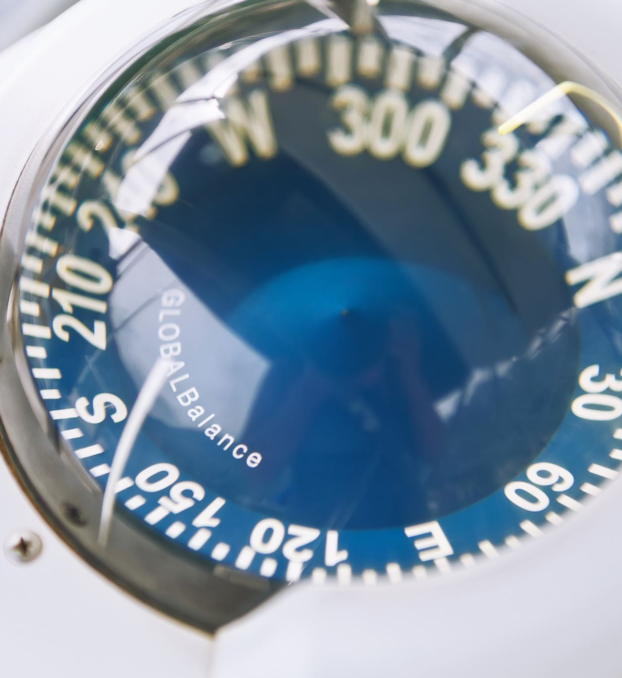
PAN PACIFIC AERO PRODUCTS AND SERVICES
Aviation Cultural Apparels, Outfits and Accessories
Jerry Liu, Founder

Slide 2
ABOUT PAN PACIFIC AERO
Founded in March 2024.
Everything is aviation-oriented.
We have:
A dedication to bring quality products
A willingness to develop education
A commitment to benefit the public.

Slide 3
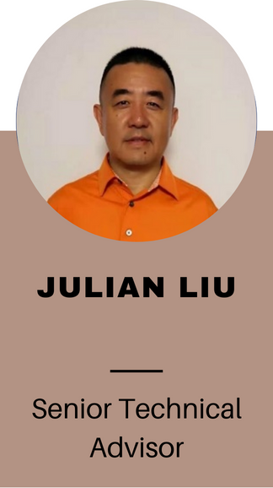
NOT ANY MOM-AND-POP SHOP

Slide 4
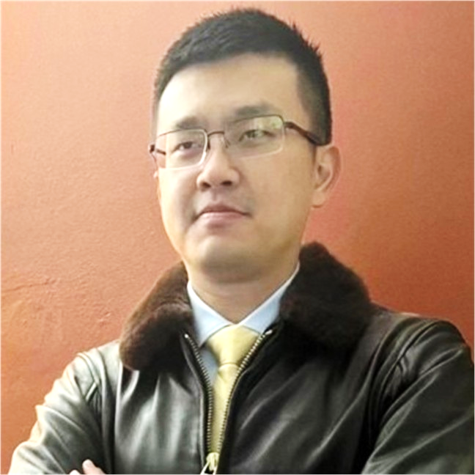
JERRY LIU
Founder and owner of Pan Pacific Aero
A graduate from Embry Riddle Aeronautical University
A certified Safety Professional and a commercial pilot AMEL
Advanced Ground Instructor
AS9100 quality management program experience
A full passion in aviation industry
Dual language = dual cultural background, which leads to:
Dual market opportunities

Slide 5
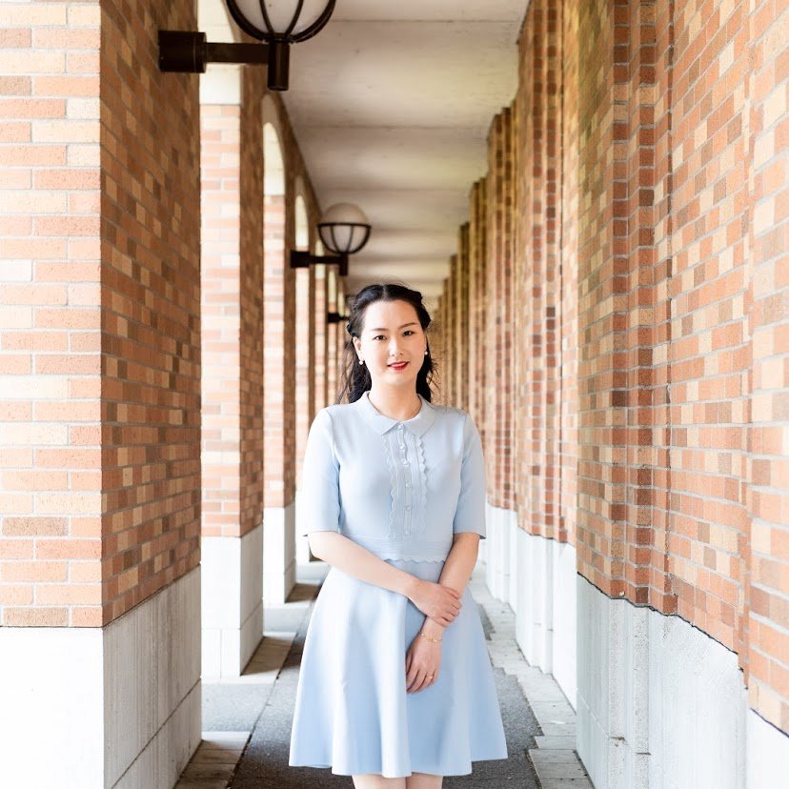
LISA ZANG
Co-founder
MPA graduate from UW.
Various experiences in company management
HR, marketing, accounting, supplier management, and customer management
Dual language = dual cultural background, which leads to:
Dual market opportunities

Slide 6
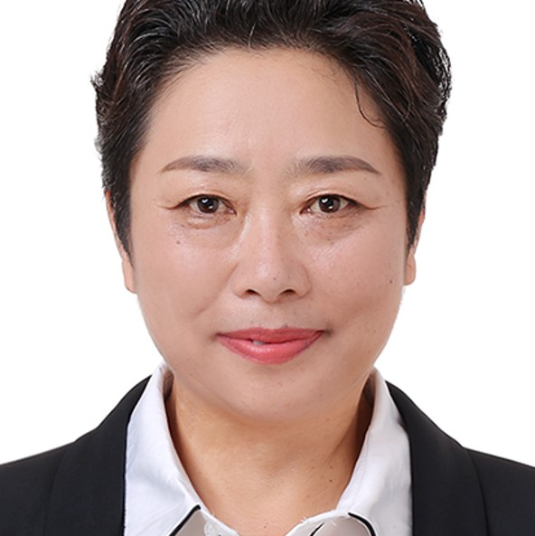
AMY ZHANG
Senior Advisor.- 40+ years in international aviation.
Intensive background in international aviation trade businesses
Numerous successful business cases with major aviation OEMs
Past project including Prototype flight test support; aircraft modification; AOG onsite support; Part sales
Education background in aircraft structures
A fully-dedicated career in aviation

Slide 7
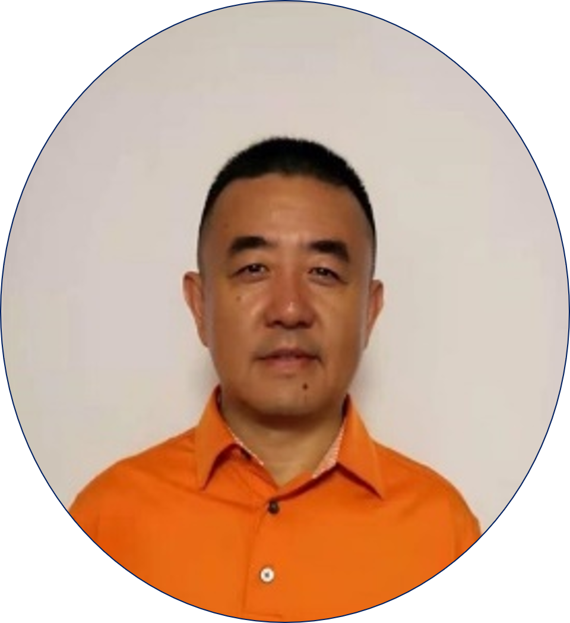
JULIAN LIU
Senior Technical Advisor- 40+ years in airline industry.
CEO of many start-up Southeast Asia airlines
The person-in-charge who: established a branch company of a Star-Alliance™ airline
Program manager of the same airline that formed in the 90s with all B737 fleet
Extensive experience in airline business
Past project involved: Implementation of the SMS program in the airline. Set up the basis of the airline website in the 90s. Fleet diversify program in the early 2000s. Wide-body expansion project
Educational background in vehicular automation

Slide 8
ROSE HANG
A team of professionals
Rose Hang – Senior Educational Advisor. 40+ years in education.
Educational professional for over 35 years.
Specializes in Pre-K to 8th grade education and personal development.
Emphasis in extra-curricular education including STEM expansion.
Past projects including school field trips domestically and internationally.
STEM implementation for school extracurricular program.
International students may not have the luxury to visit the Museum physically, but Yanmin can bring the Museum to them in their hometown*.
*After an authorization from the Museum

Slide 9
HOODED SWEATSHIRT (HOODIES)

Slide 10
T-SHIRT

Slide 11
DRAWSTRING BACKPACK

Slide 12
SPORTS/BATH TOWEL

Slide 13
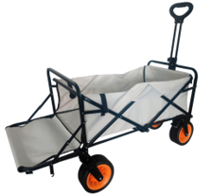
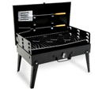
OUTDOORS
Coffee Grinders

Slide 14
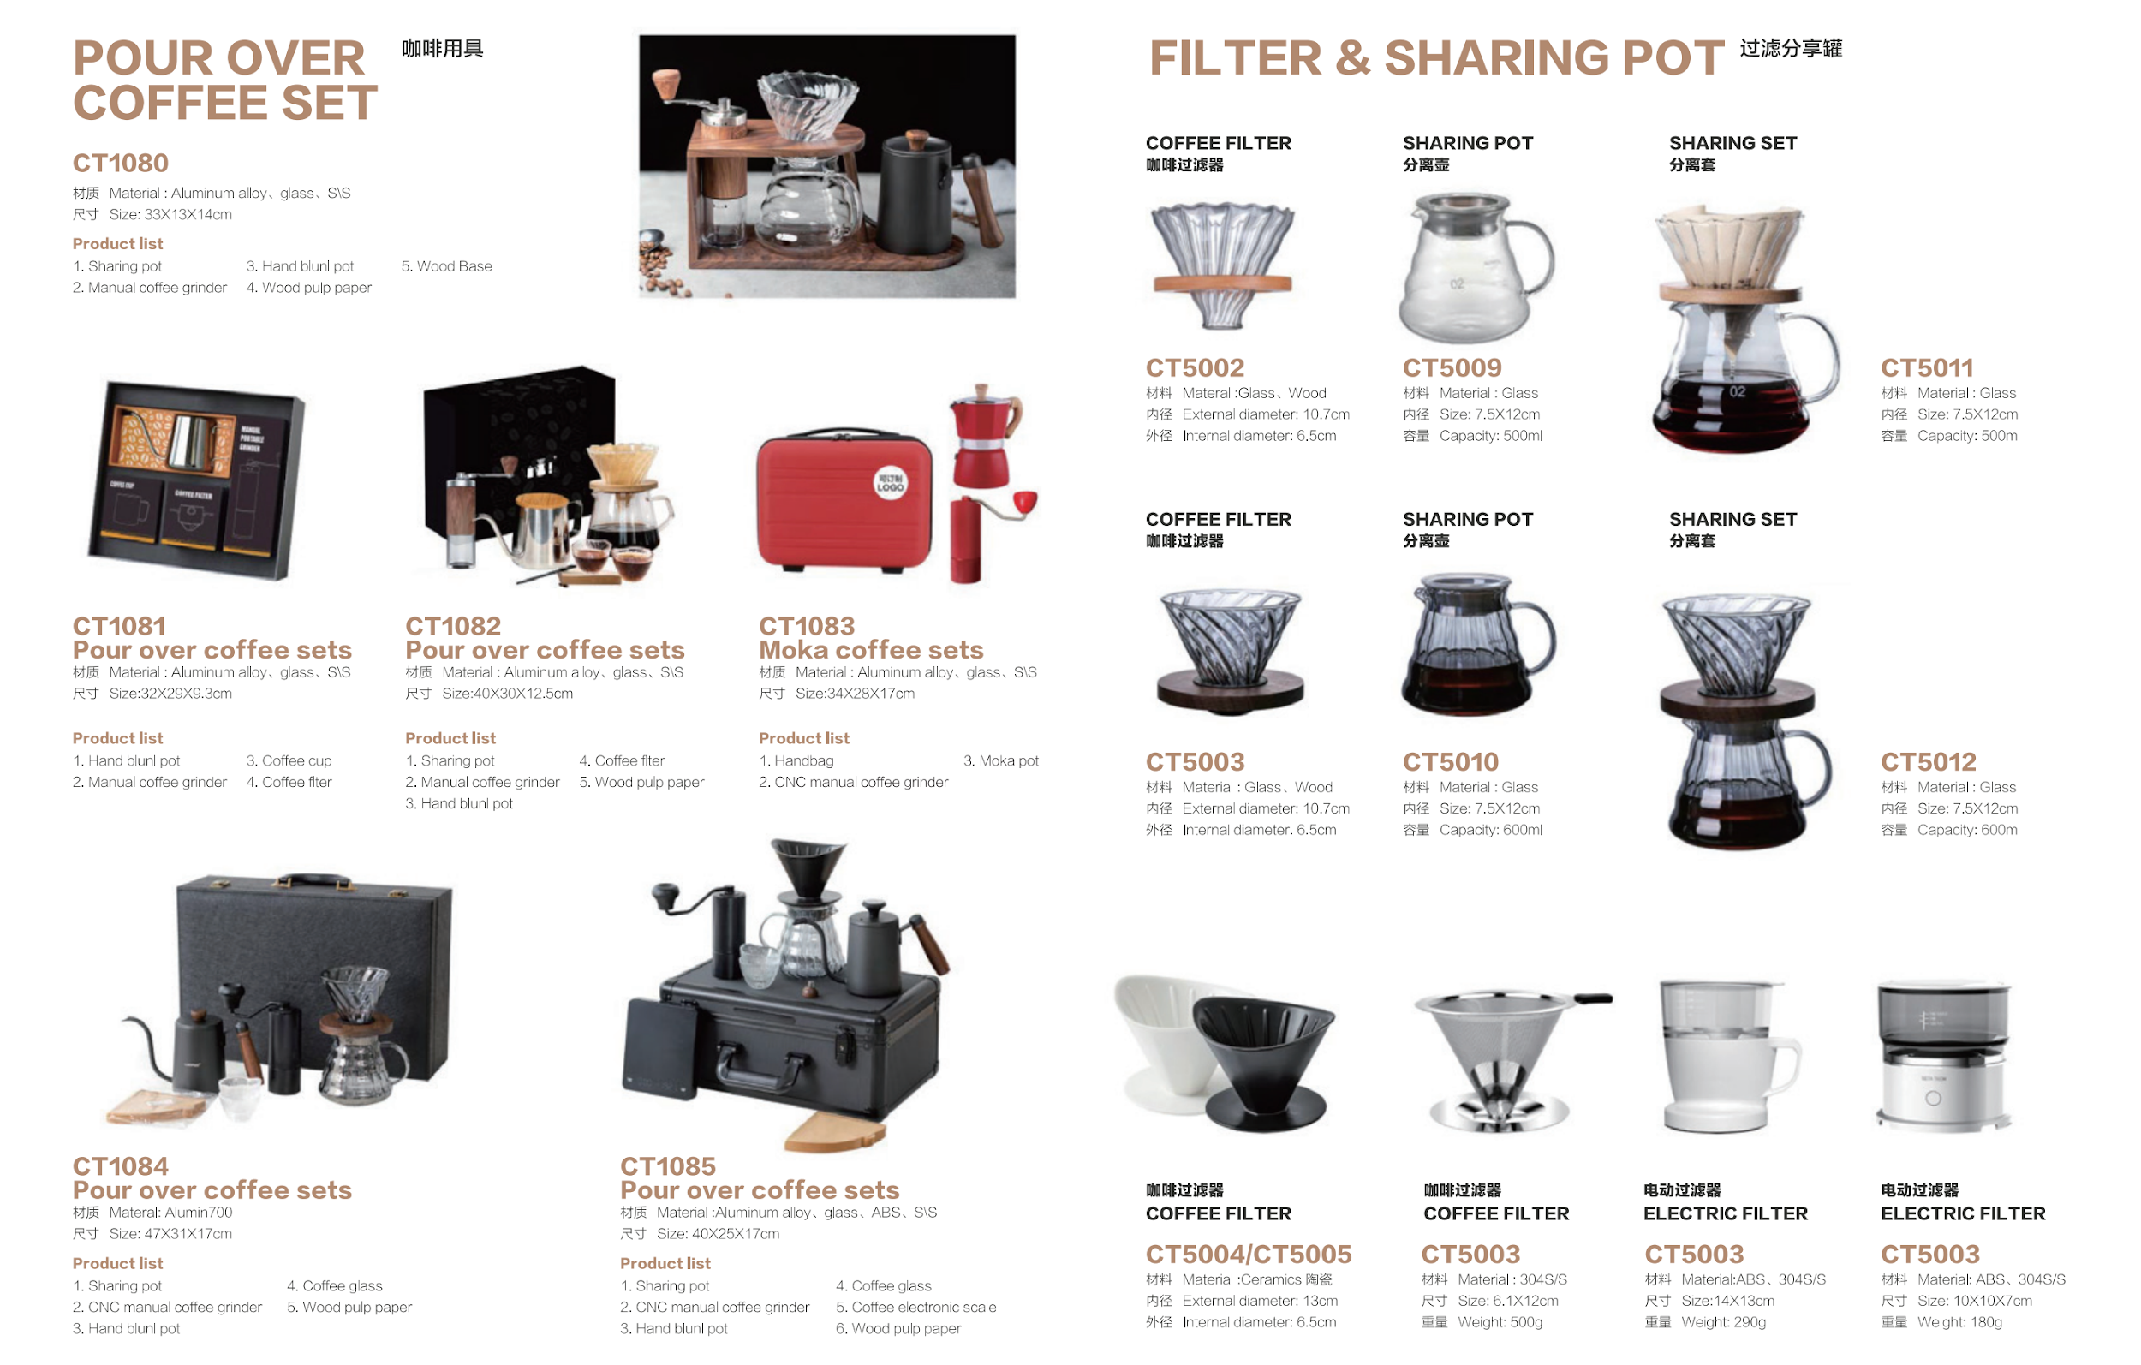
OUTDOORS
Coffee Grinders

Slide 17
OTHER AVAILABLE PRODUCTS

Slide 18
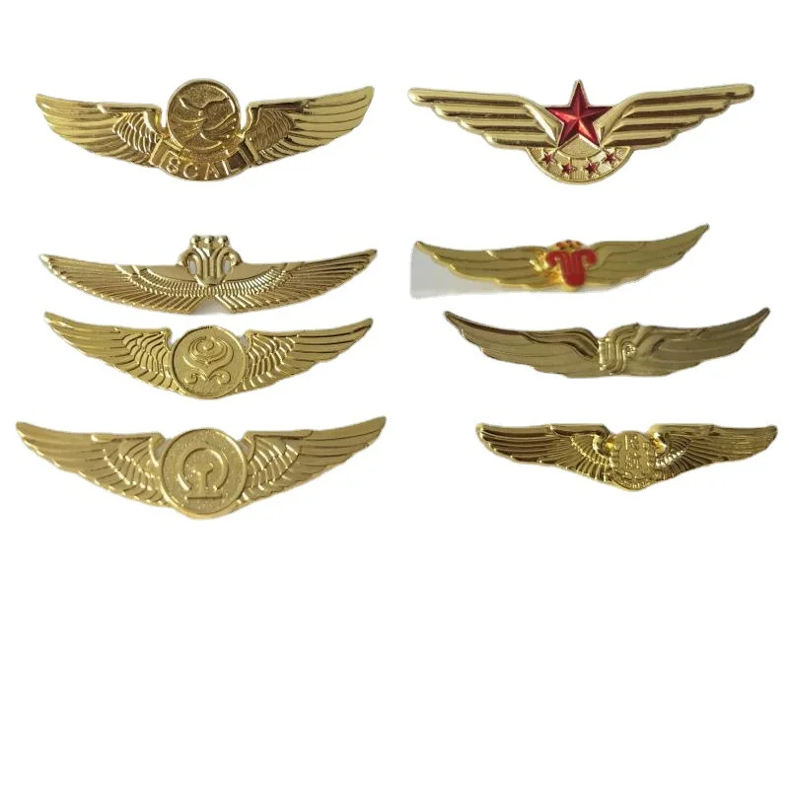
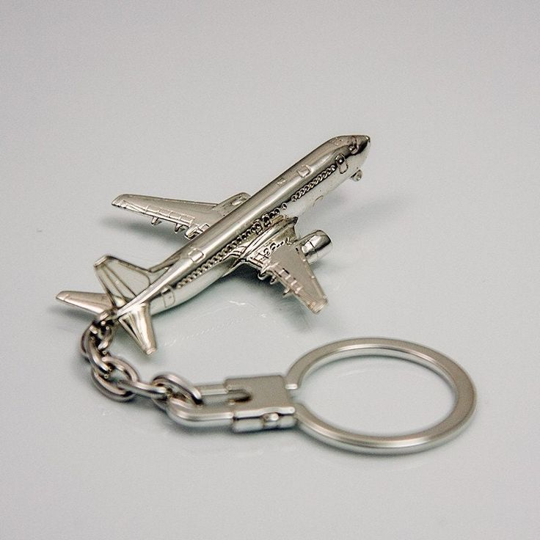
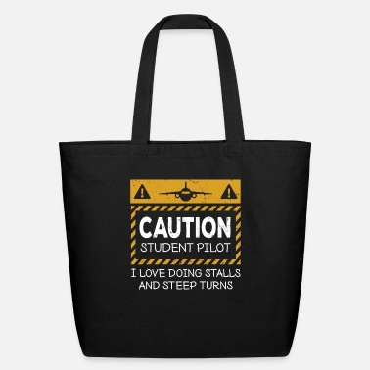
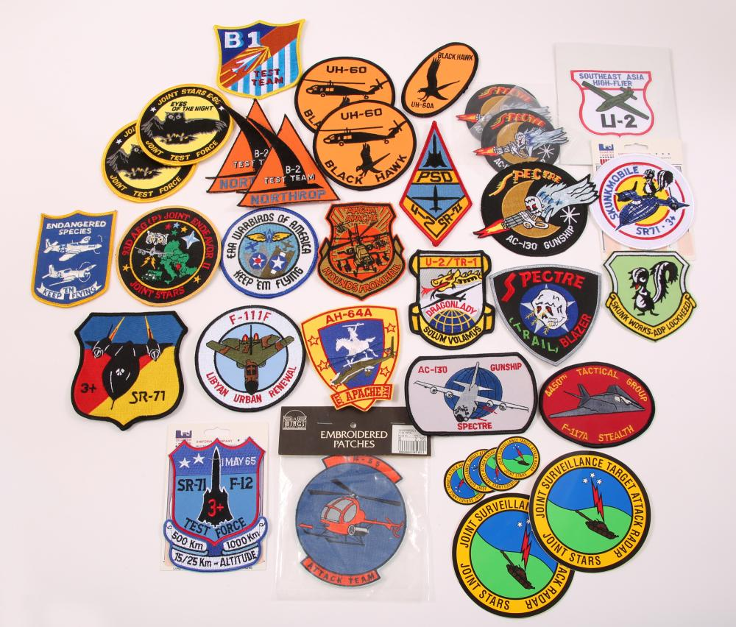
OTHER AVAILABLE PRODUCTS
In work:
All available upon request.
A case-by-case scenario in quoting.
Various OEMs with the highest quality inspections (by Jerry).
Key chains
Wing insignias
Aviation patches
Tote bags

Slide 19
THANK YOU!
We wish to serve the public together with you!
We hope that we have brought something interested to you.
We promise that we will keep our commitment in bringing the benefits to the public, through many retail stores like you!
Thank you for your consideration!
Contact- Jerry Liu
386-681-7794
Jerry.liu@pan-pacific.aero

